Slide 1
Elasticity and its application

Slide 2
Elasticity of Demand
A higher price will lead to a lower quantity demanded. What you may not know is how much lower the quantity demanded will be. Similarly, the law of supply states that a higher price will lead to a higher quantity supplied. The question is: How much higher? This chapter will explain how to answer these questions and why they are critically important in the real world.
To find answers to these questions, we need to understand the concept of elasticity.
Elasticity is an economics concept that measures responsiveness of one variable to changes in another variable.

Slide 3
Taxes on Cigarettes (Sin Tax)
Government increasing the National Calamity Contingent Duty (NCCD) on cigarettes anywhere between 212% to 388% depending on cigarette stick sizes.
Price of cigarettes will go up by 6-7% in case of lower priced packs where the stick size is small and has borne the maximum increase in duties, while for the larger size sticks and premium packs the price hike will be 4 to 5%. In her Budget speech, finance minister Nirmala Sitharaman said: “As a revenue measure, I propose to raise excise duty, by way of National Calamity Contingent Duty on cigarettes and other tobacco products.

Slide 4
Elasticity
Elasticity is the measure of the responsiveness of quantity demanded or quantity supplied to a change in one of its determinants.
Elastic change-We can usefully divide elasticities into three broad categories: elastic, inelastic, and unitary.
An elastic demand or elastic supply is one in which the elasticity is greater than one (e > 1), indicating a high responsiveness to changes in price.
Elasticities that are less than one (e<1) indicate low responsiveness to price changes and correspond to inelastic demand or inelastic supply.
Unitary elasticities indicate proportional responsiveness of either demand or supply (e = 1).

Slide 5
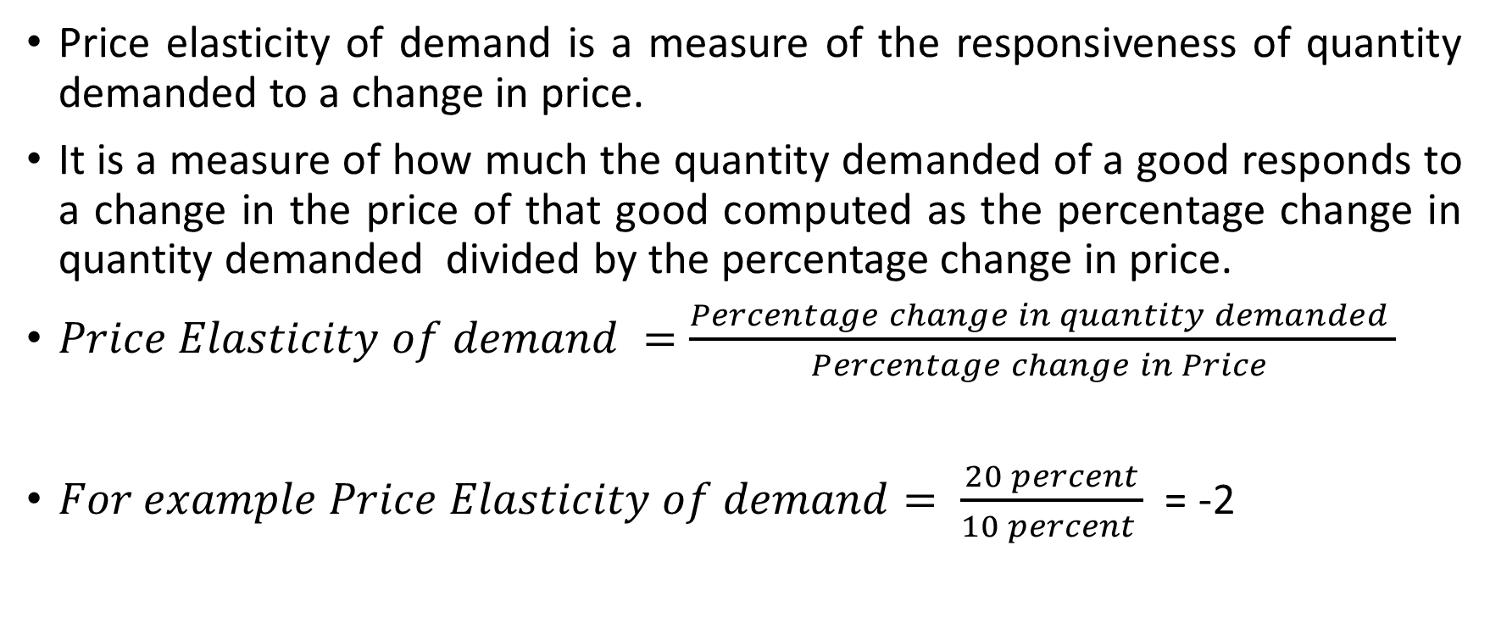
Price Elasticity of Demand
Price elasticity of demand is a measure of the responsiveness of quantity demanded to a change in price.
It is a measure of how much the quantity demanded of a good responds to a change in the price of that good computed as the percentage change in quantity demanded divided by the percentage change in price.
$Price Elasticity of demand =\frac{Percentage change in quantity demanded }{Percentage change in Price }$
$For example Price Elasticity of demand= \frac{20 percent}{10 percent }$ = -2

Slide 6
Determinants of Price Elasticity of Demand
Availability of close substitutes
The more the substitutes the more the elastic the demand will be.
The share of the budget spent on the good
Eg 1- Purchase of Smart TV
Eg 2-Purchase of inexpensive items
Necessary Vs Luxury Goods
Goods which people see as necessities will have inelastic demand (water ,electricity, LPG, house rent)
Luxury goods will have elastic demand

Slide 7
Determinants of Price elasticity of Demand
Time and Adjustment process
Immediate run-inelastic demand
Short run – elastic demand
Long run – elastic demand

Slide 8
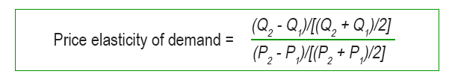
Computing the Price Elasticity of Demand
Percentage Method
Mid Point method or Arc elasticity
Point Elasticity
Mid Point Method –

Slide 9
Practice Problem on Mid point Method
Calculate only the ARC elasticity for the following. In each case state whether the calculated value is elastic, inelastic, or unitary.
1. P₀ = $89; Q₀ = 1000; P₁ = $99; Q₁ = 950 2. P₀ = $89; Q₀ = 1000; P₁ = $99; Q₁ = 700 3. P₀ = $69; Q₀ = 200; P₁ = $79; Q₁ = 195 4. P₀ = $3.99; Q₀ = 12,000; P₁ = $3.79; Q₁ = 12,950

Slide 10
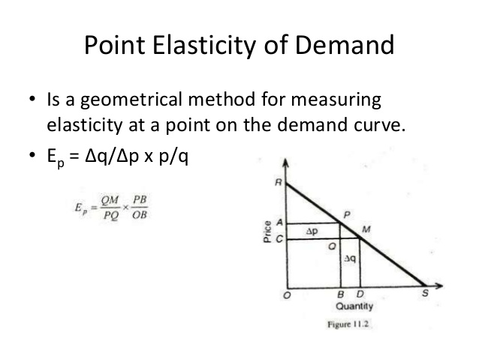
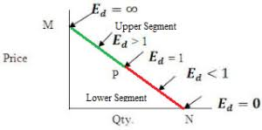
Point Elasticity

Slide 11
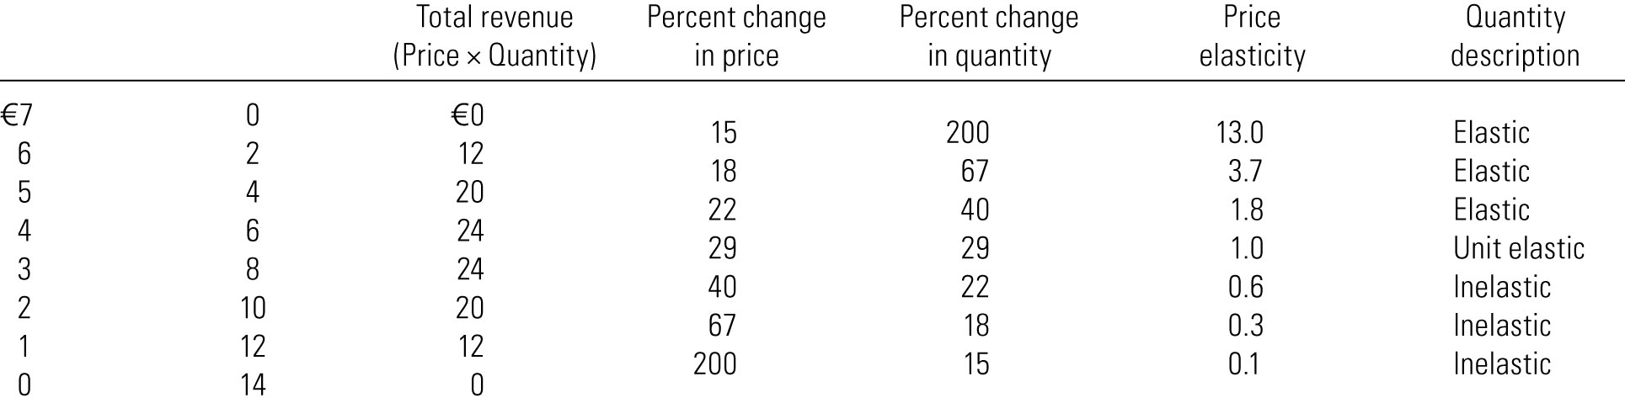
Elasticity of a Linear Demand Curve

Slide 12
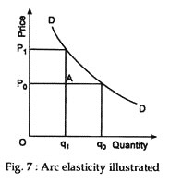
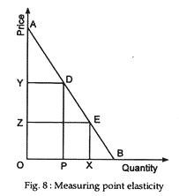
Difference between Arc elasticity and point elasticity
Point elasticity
Arc elasticity
Arc elasticity is measured over an arc of demand curve.
Point elasticity refers to measuring elasticity of demand at a particular point on the demand curve.

Slide 13
Practice Problem on Point Elasticity
The demand function for a cola-type drink in general is:
Qd = 20 - 2P
Calculate the point elasticity of demand at prices of $5 and $9.

Slide 14

Figure 1 The Price Elasticity of Demand
(a) Perfectly Inelastic Demand: Elasticity Equals 0
Price
Demand
€ 5
4
1. An
increase
in price . . .
0
100
Quantity
2. . . . leaves the quantity demanded unchanged.
Copyright©2003 Southwestern/Thomson Learning

Slide 15
Figure 1 The Price Elasticity of Demand
(b) Inelastic Demand: Elasticity Is Less Than 1
Price
€ 5
4
1. A 22%
Demand
increase
in price . . .
0
90
100
Quantity
2. . . . leads to an 11% decrease in quantity demanded.

Slide 16
Figure 1 The Price Elasticity of Demand
(c) Unit Elastic Demand: Elasticity Equals 1
Price
€ 5
4
1. A 22%
Demand
increase
in price . . .
0
80
100
Quantity
2. . . . leads to a 22% decrease in quantity demanded.
Copyright©2003 Southwestern/Thomson Learning

Slide 17
Figure 1 The Price Elasticity of Demand
(d) Elastic Demand: Elasticity Is Greater Than 1
Price
€ 5
4
Demand
1. A 22%
increase
in price . . .
0
50
100
Quantity
2. . . . leads to a 67% decrease in quantity demanded.

Slide 18
Figure 1 The Price Elasticity of Demand
(e) Perfectly Elastic Demand: Elasticity Equals Infinity
Price
1. At any price
above €4, quantity
demanded is zero.
€ 4
Demand
2. At exactly €4,
consumers will
buy any quantity.
0
Quantity
3. At a price below €4,
quantity demanded is infinite.

Slide 19
Figure 2 Total Revenue
Price
€4
P × Q = €400
P
(revenue)
Demand
0
100
Quantity
Q
Copyright©2003 Southwestern/Thomson Learning

Slide 20
Elasticity and Total Revenue Along a Linear Demand Curve
Total revenue = Price × Quantity
When Demand is Inelastic (Price elasticity less than 1) Price and Total Revenue moves in same Direction i.e Price increases, TR also increases.
When Demand is elastic (Price elasticity greater than 1) Price and Total Revenue moves in opposite direction. Price increases and TR decreases.
When Demand is unit elastic (Price elasticity equal to 1) Total Revenue remains constant when price changes.

